Slide 1


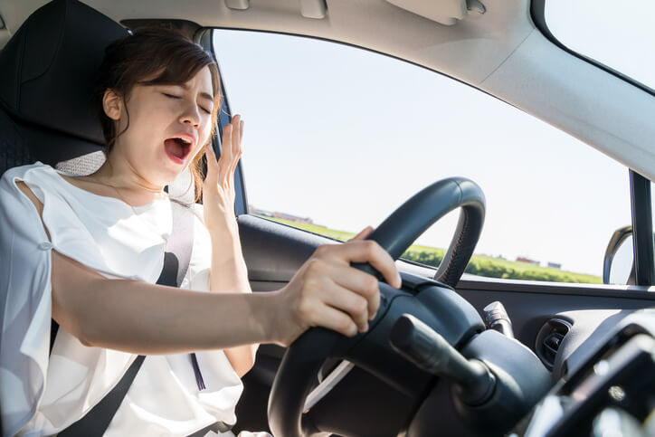
RAJ KUMAR GOEL INSTITUTE OF TECHNOLOGY GHAZIABAD
B.TECH IN COMPUTER SCIENCE ENGINEERING
SESSION:-2020-2021
TITLE OF SYNOPSIS:DRIVER DROWSINESS DETECTION
UNDER THE SUPERVISION OF
GUIDE NAME:DR.SACHI GUPTA
SUBMITTED BY:
1.PRINCY UPADHYAY(1703310139)
2.SHRIYA GOYAL(1703310195)
3.LAUREN JAIN(1703310102)
4.SATYA MISHRA(1703310176)

Slide 2
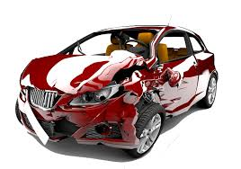
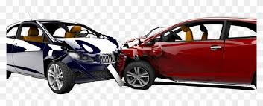
Road accident rate
According National Crime Records Bureau(NCRB)Over 1,48,707 people were killed in road accidents.
Two wheelers account for 25% of total road crash deaths.
There is one death every 4 minutes due to a road accident in India.
India ranks 1st in the number of road accidents

Slide 3
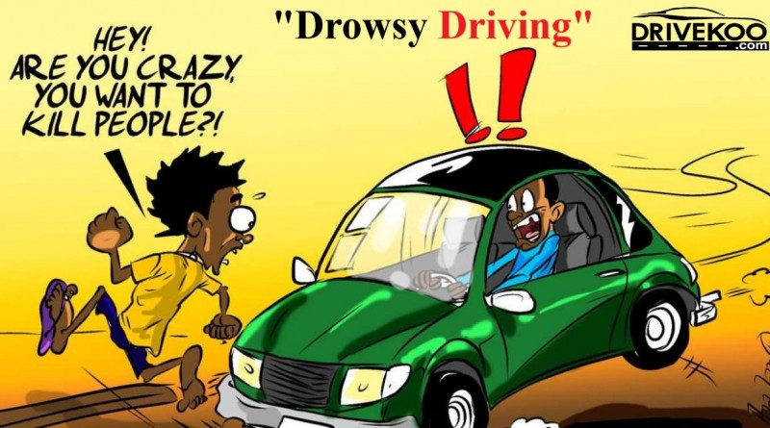
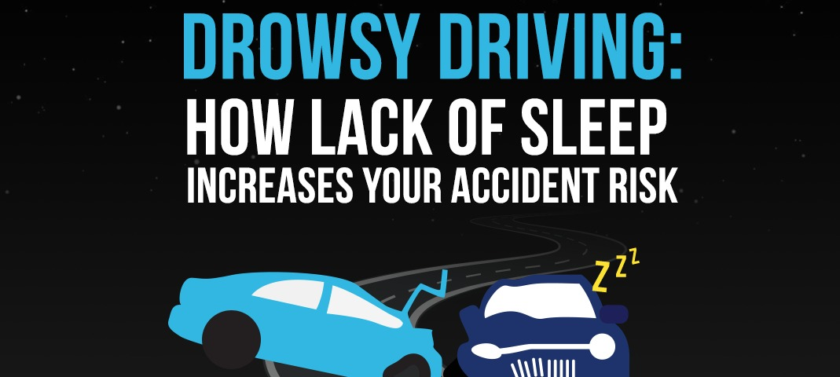
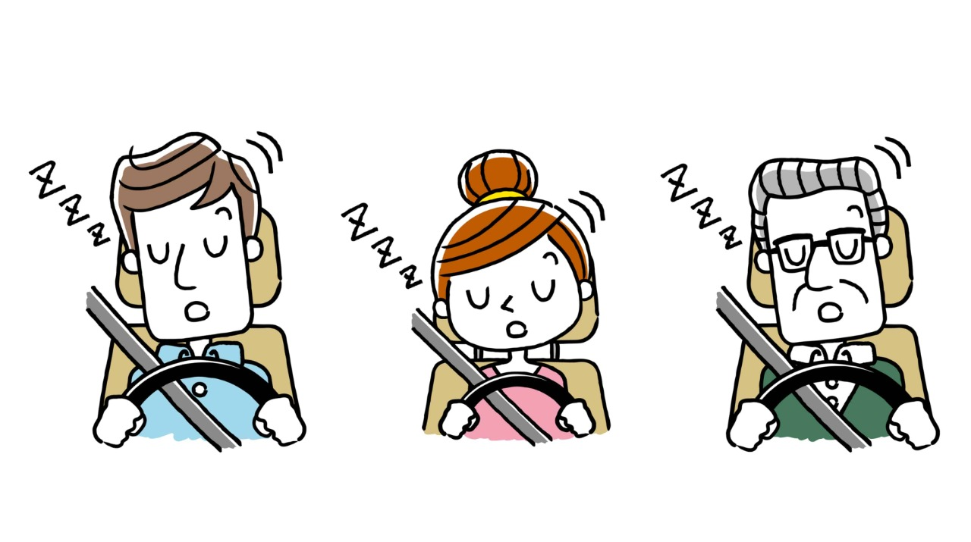
RATE OF ACCIDENTS DUE TO DROWSINESS
ACCORDING TO NSF ABOUT 37 % OR 103 MILLION PEOPLE HAVE FALLEN ASLEEP AT THE WHEEL
21% OF ALL FATAL ACCIDENTS ARE DUE TO DROWSY DRIVING.
NATIONAL HIGHWAY TRAFFIC SAFETY ADMINISTRATION ESTIMATES THAT 100,000 ACCIDENTS ARE DIRECT RESULT OF DRIVER FATIQUE EVERY YEAR

Slide 4
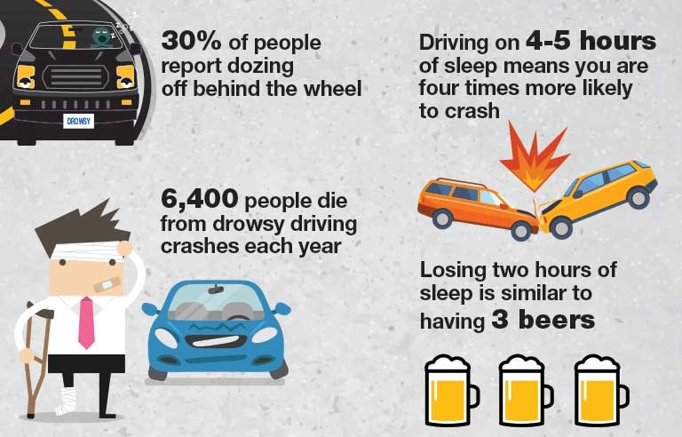
Reason for developing this project

Slide 5
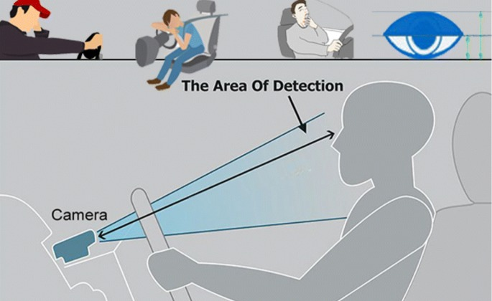
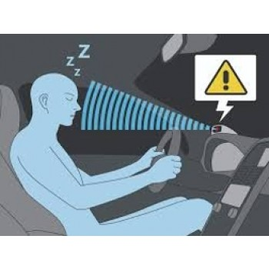
Problem statement
Design a prototype Driver Drowsiness Detection System using Computer vision

Slide 6
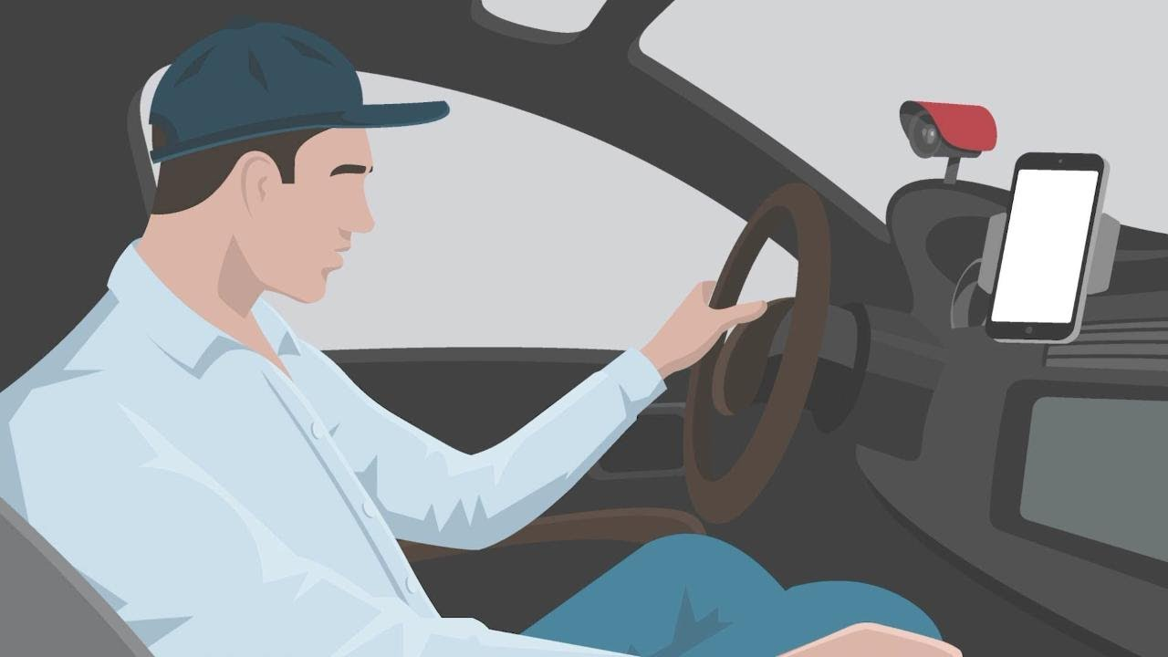
Objective and scope of project
Our objective of the project is to ensure the safety system to avoid accidents.
Objective
This project can be integrated with external camera in car, so that we can automatically detect driver's face.
Scope

Slide 7
INFERENCEs form Literature Survey
Literature Survey
Technique 1-Vehicle based measure
Technique 2-Physiological measure
Technique 3-Artificial neural network based
Technique 4-Subjective measure
Technique5-Behavioral measures
Technique5-Behavioral measures

Slide 8
Solution/Methodology
Video Input
Dividing video into frames
Fetch Frame
Face Detection
Feature Extraction
Eye State
Mouth State
Eye closure and blinking Ratio
Mouth Opening and closure
Is it a Drowsy state?
NO
Yes
Warning

Slide 9
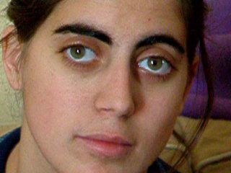
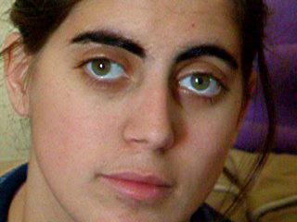
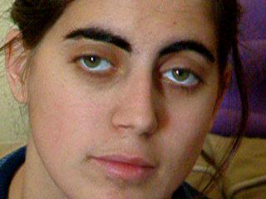
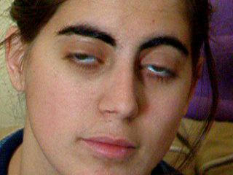
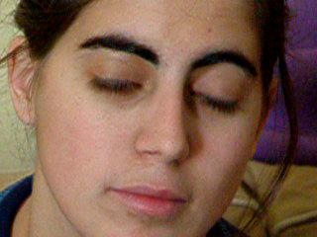
Implementation – Step by Step (1)
30 frames
per second

Slide 10
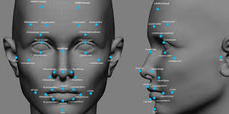
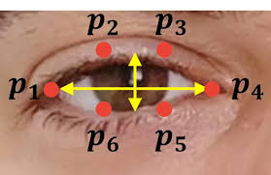
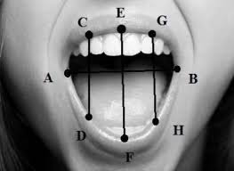
Implementation – Step by Step (2)
Implementation – Step by Step (3)
Implementation – Step by Step (4)

Slide 11
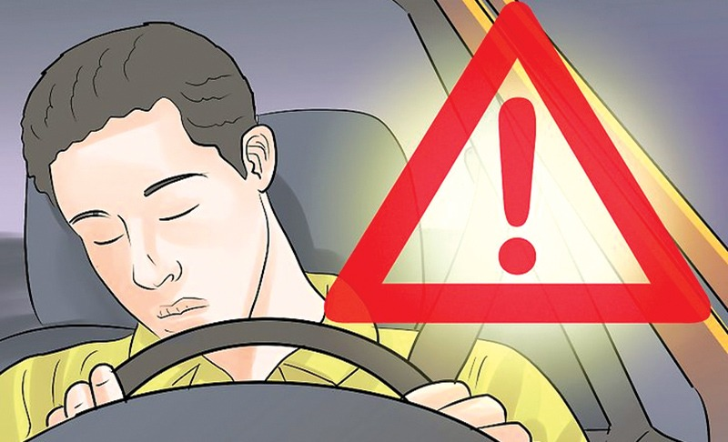

Implementation – Step by Step (5)
Implementation – Step by Step (6)

Slide 12
Conclusion

Slide 13
THANK YOU

